Slide 1


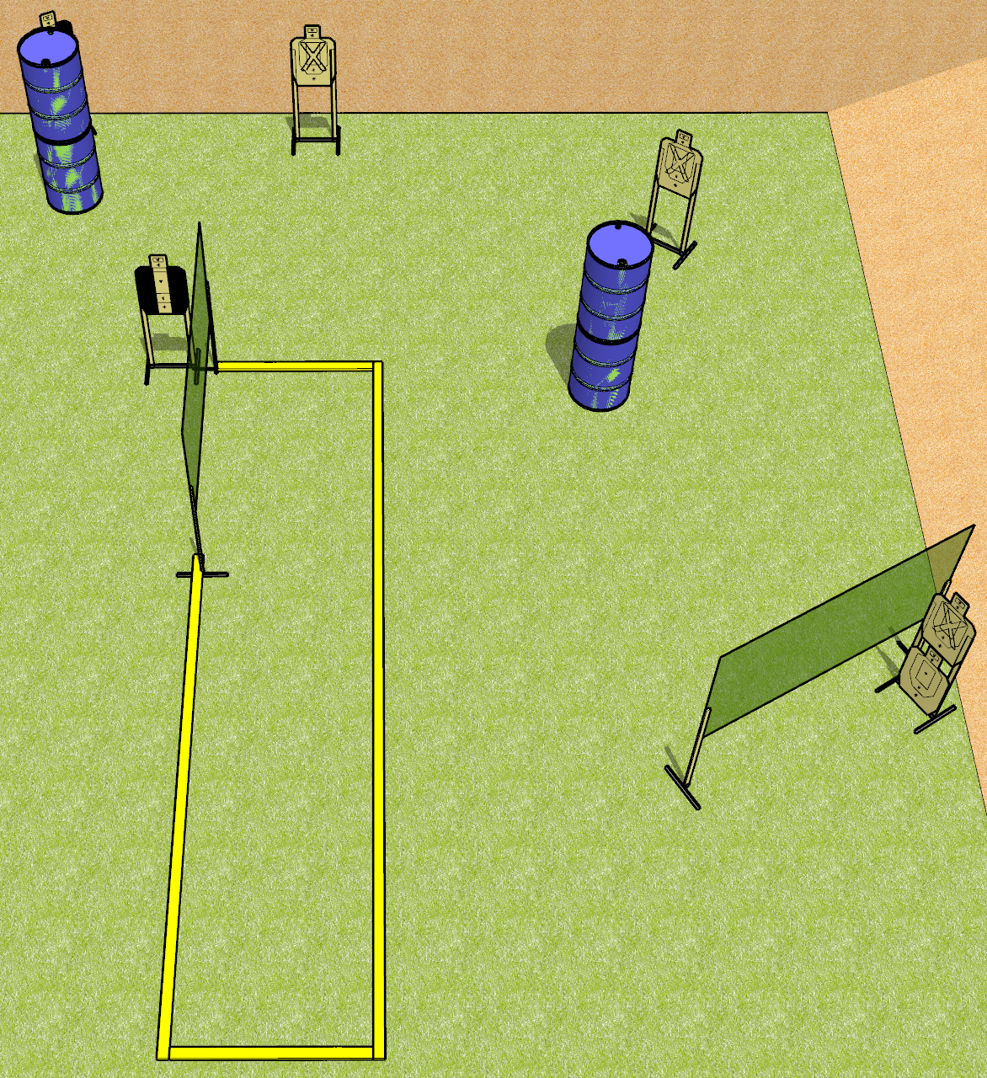
 | Dothan Gun Club – USPSA Match Short and Simple Course Designer : Drew Coleman
START POSITION : Standing with both toes touching rearmost faultline, wrists below belt
GUN READY CONDITION : Pistol loaded and holstered. PCC loaded, buttstock on belt, safety on. |  | SCORING: Comstock, 12 rounds TARGETS: 6 paper, 0 Steel SCORED HITS: Best 2 on paper, steel until down START-STOP: Audible, last shot RULES:
STAGE PROCEDURE: Engage targets as they become available from within the fault lines.

Slide 2
Short and Simple
Written Stage Briefing
Short and Simple is a 12 round, 60 point, Comstock short course. There are six USPSA targets. The best two hits on paper will score. The start signal is audible.
Handgun start position is standing with toes touching the rearmost fault line, outside the shooting area, wrists below belt. Handgun is loaded and holstered
PCC start position start position is standing with toes touching the rearmost fault line, outside the shooting area, buttstock on belt. Loaded carbine is held with both hands, safety on.
On start signal, engage targets from within the shooting area.

Slide 3
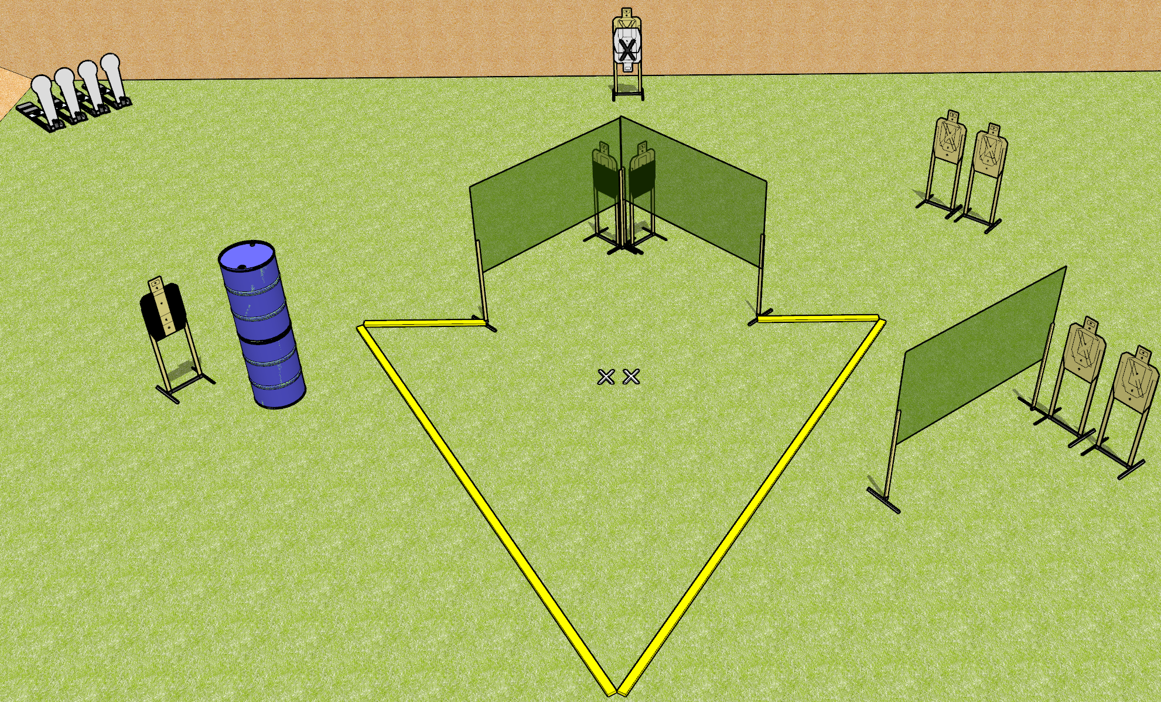
 | Dothan Gun Club – USPSA Match What am I up to? Course Designer : Drew Coleman
START POSITION : Standing with both feet on X’s, wrists below belt
GUN READY CONDITION : Pistol loaded and holstered. PCC loaded, shouldered, safety on, pointed at orange cone. |  | SCORING: Comstock, 20 rounds TARGETS: 8 paper, 4 Steel SCORED HITS: Best 2 on paper, steel until down START-STOP: Audible, last shot RULES:
STAGE PROCEDURE: Engage targets as they become available from within the fault lines.

Slide 4
What am I up to?
Written Stage Briefing
What am I up to? is a 20 round, 100 point, Comstock medium course. There are eight USPSA targets and four Colt poppers. The best two hits on paper will score and steel must fall to score. The start signal is audible.
Handgun start position is standing with both feet on X’s, wrists below belt. Handgun is loaded and holstered.
PCC start position is standing with both feet on X’s, muzzle pointed at orange cone. Loaded carbine is held with both hands, safety on.
On start signal, engage targets as they become available from within the shooting area.

Slide 5
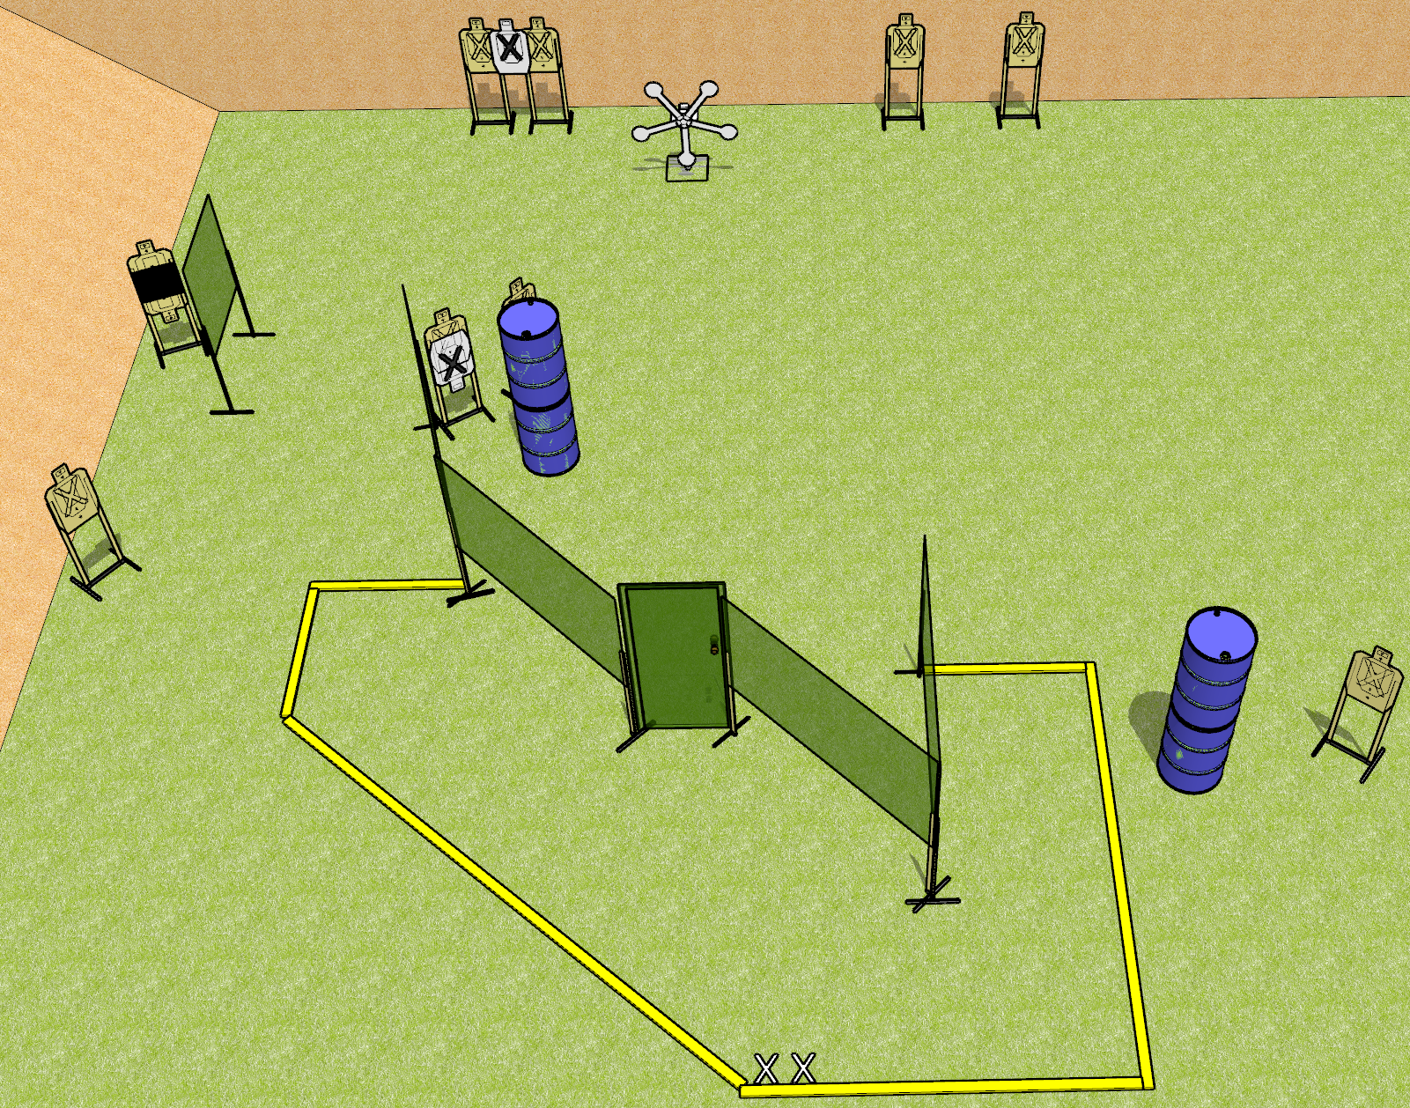
 | Dothan Gun Club – USPSA Match Just a Star Course Designer : Drew Coleman
START POSITION : Standing with both feet on X’s, wrists below belt
GUN READY CONDITION : Pistol loaded and holstered. PCC loaded, shouldered, safety on, pointed at orange cone. |  | SCORING: Comstock, 25 rounds TARGETS: 10 paper, 5 Steel SCORED HITS: Best 2 on paper, steel until down START-STOP: Audible, last shot RULES:
STAGE PROCEDURE: Engage targets as they become available from within the fault lines.

Slide 6
Just a Star
Written Stage Briefing
Just a Star is a 25 round, 125 point, Comstock field course. There are ten USPSA targets and five falling plates. The best two hits on paper will score, and steel must fall to score. The start signal is audible.
Handgun start position is standing with both feet on X’s, wrists below belt. Handgun is loaded and holstered.
PCC start position is standing with both feet on X’s, muzzle pointed at orange cone. Loaded carbine is held with both hands, safety on.
On start signal, engage targets as they become available from within the shooting area.

Slide 7
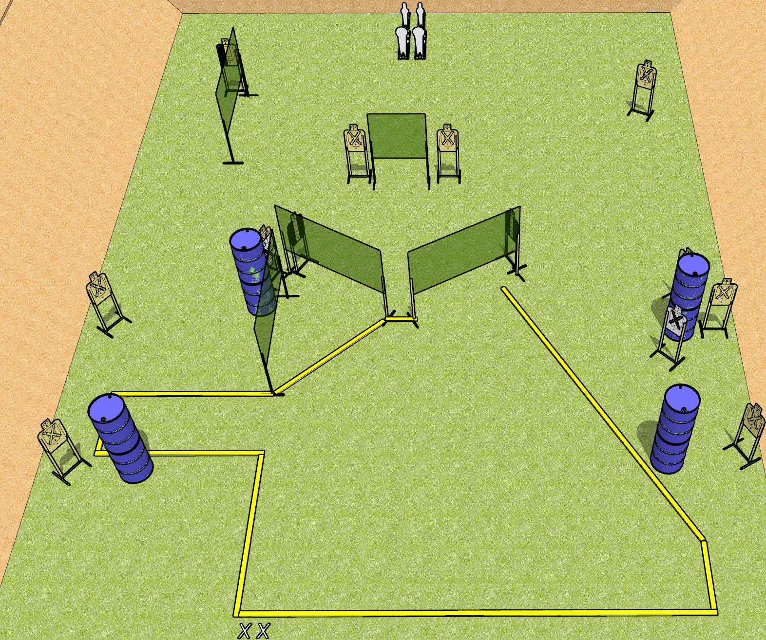
 | Dothan Gun Club – USPSA Match Mutant Course Designer : Drew Coleman
START POSITION : Standing with both feet on X’s, wrists below belt
GUN READY CONDITION : Pistol loaded and holstered. PCC loaded, shouldered, safety on, pointed at orange cone. |  | SCORING: Comstock, 28 rounds TARGETS: 12 paper, 4 Steel SCORED HITS: Best 2 on paper, steel until down START-STOP: Audible, last shot RULES:
STAGE PROCEDURE: Engage targets as they become available from within the fault lines.

Slide 8
Mutant
Written Stage Briefing
Mutant is a 28 round, 140 point, Comstock field course. There are twelve USPSA targets, two colt poppers, and two mini poppers. The best two hits on paper will score and steel must fall to score. The start signal is audible.
Handgun start position is standing with both feet on X’s, wrists below belt. Handgun is loaded and holstered.
PCC start position is standing with both feet on X’s, muzzle pointed at orange cone. Loaded carbine is held with both hands, safety on.
On start signal, engage targets as they become available from within the shooting area.

Slide 9
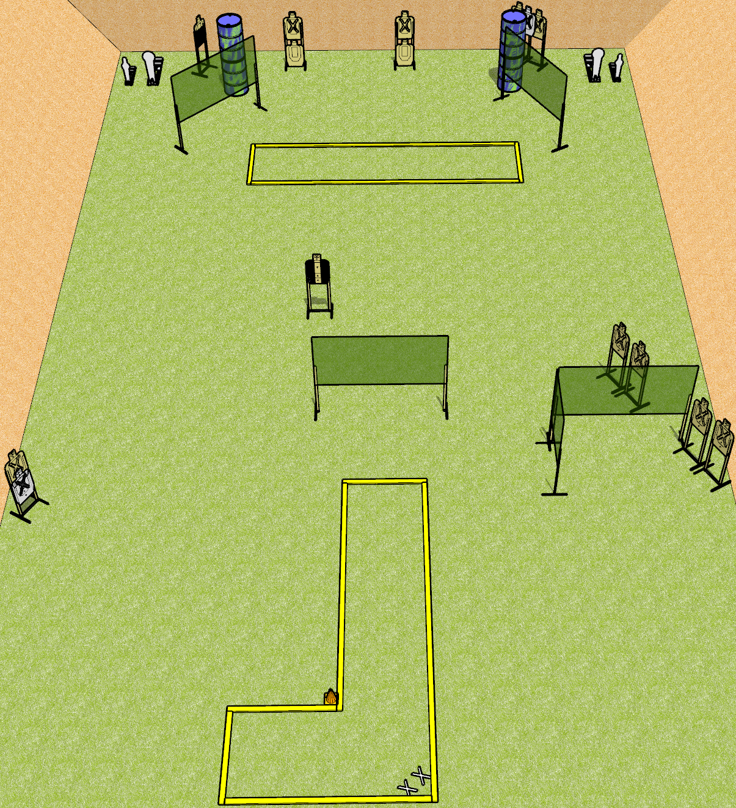
 | Dothan Gun Club – USPSA Match Keep it Simple Course Designer : Drew Coleman
START POSITION : Standing with both feet on X’s, wrists below belt
GUN READY CONDITION : Pistol loaded and holstered. PCC loaded, shouldered, safety on, pointed at orange cone. |  | SCORING: Comstock, 30 rounds TARGETS: 13 paper, 4 Steel SCORED HITS: Best 2 on paper, steel until down START-STOP: Audible, last shot RULES:
STAGE PROCEDURE: Engage targets as they become available from within the fault lines.

Slide 10
Keep it Simple
Written Stage Briefing
Keep it Simple is a 30 round, 150 point, Comstock field course. There are thirteen USPSA targets, two Colt poppers, and two mini poppers. The best two hits on paper will score, and steel must fall to score. The start signal is audible.
Handgun start position is standing with both feet on X’s, wrists below belt. Handgun is loaded and holstered.
PCC start position is standing with both feet on X’s, muzzle pointed at orange cone. Loaded carbine is held with both hands, safety on.
On start signal, engage targets as they become available from within the shooting area.

Slide 11
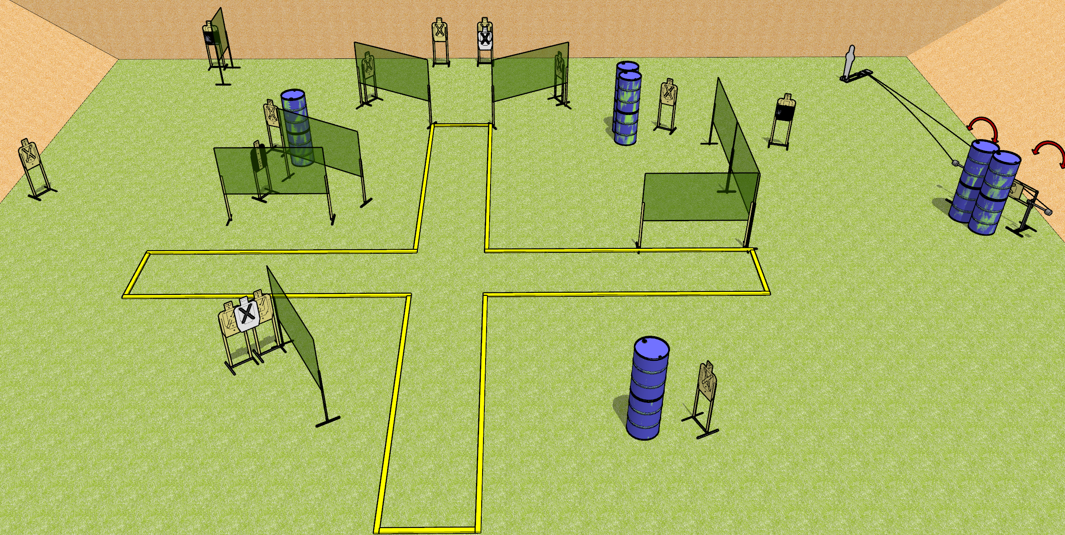
 | Dothan Gun Club – USPSA Match Plus Sized Course Designer : Drew Coleman
START POSITION : Standing anywhere inside the shooting area, wrists below belt
GUN READY CONDITION : Pistol loaded and holstered. PCC loaded, buttstock on belt, safety on. |  | SCORING: Comstock, 31 rounds TARGETS: 15 paper, 1 Steel SCORED HITS: Best 2 on paper, steel until down START-STOP: Audible, last shot RULES:
STAGE PROCEDURE: Engage targets as they become available from within the fault lines.

Slide 12
Plus Sized
Written Stage Briefing
Plus Sized is a 31 round, 155 point, Comstock field course. There are fifteen USPSA targets and one pepper popper. The best two hits on paper will score, and steel must fall to score. The start signal is audible.
Swinging targets one and two are activated by pepper popper one.
Handgun start position is standing anywhere inside the shooting area, wrists below belt. Handgun is loaded and holstered.
PCC start position is standing anywhere inside the shooting area. Loaded carbine is held with both hands, safety one, buttstock on belt.
On start signal, engage targets as they become available from within the shooting area.

Slide 13
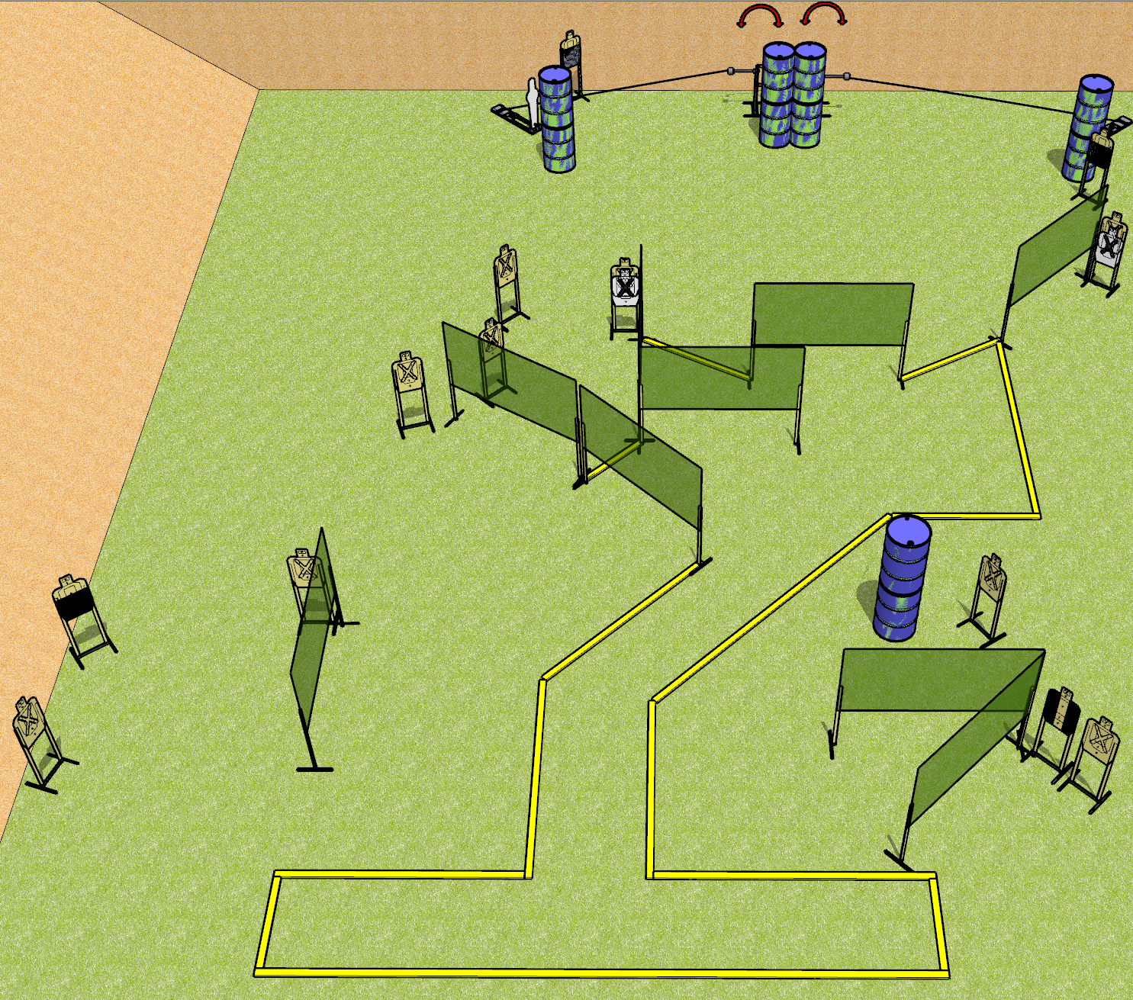
 | Dothan Gun Club – USPSA Match All Bent Up Course Designer : Drew Coleman
START POSITION : Standing with both heels against the rearmost fault line, inside the shooting area, wrists below belt
GUN READY CONDITION : Pistol loaded and holstered. PCC loaded, shouldered, safety on, pointed at orange cone. |  | SCORING: Comstock, 32 rounds TARGETS: 15 paper, 2 Steel SCORED HITS: Best 2 on paper, steel until down START-STOP: Audible, last shot RULES:
STAGE PROCEDURE: Engage targets as they become available from within the fault lines.

Slide 14
All Bent Up
Written Stage Briefing
All Bent Up is a 32 round, 160 point, Comstock field course. There are fifteen USPSA targets and two pepper poppers. The best two hits on paper will score and the steel must fall to score. The start signal is audible.
Left pepper popper activates left swinger. Right pepper popper activates right swinger. Please view the activator setup prior to first shooter and reset it the same way every time.
Handgun start position is standing with both heels against the rearmost fault line, inside the shooting area, wrists below belt. Handgun is loaded and holstered.
PCC start position is standing with both heels against the rearmost fault line, inside the shooting area, muzzle pointed at orange cone. Loaded carbine is held with both hands, safety on.
On start signal engage targets as they become available from within the shooting area.

Slide 15
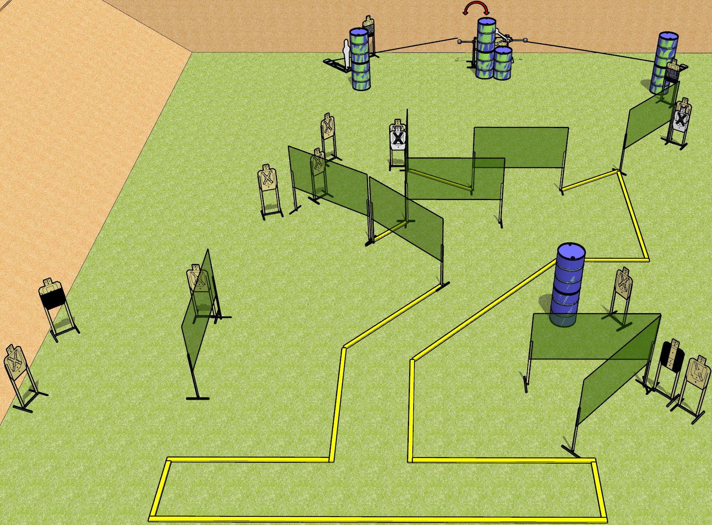
 | Dothan Gun Club – USPSA Match All Bent Up Course Designer : Drew Coleman
START POSITION : Standing with both heels against the rearmost fault line, inside the shooting area, wrists below belt
GUN READY CONDITION : Pistol loaded and holstered. PCC loaded, shouldered, safety on, pointed at orange cone. |  | SCORING: Comstock, 32 rounds TARGETS: 14 paper, 4 Steel SCORED HITS: Best 2 on paper, steel until down START-STOP: Audible, last shot RULES: all moving targets must be activated before being engaged
STAGE PROCEDURE: Engage targets as they become available from within the fault lines.

Slide 16
All Bent Up
Written Stage Briefing
All Bent Up is a 32 round, 160 point, Comstock field course. There are fifteen USPSA targets, two falling plates, and two pepper poppers. The best two hits on paper will score and the steel must fall to score. The start signal is audible.
Left pepper popper activates left swinger. Right pepper popper activates the swinging plate target. Please view the activator setup prior to first shooter and reset it the same way every time.
Handgun start position is standing with both heels against the rearmost fault line, inside the shooting area, wrists below belt. Handgun is loaded and holstered.
PCC start position is standing with both heels against the rearmost fault line, inside the shooting area, muzzle pointed at orange cone. Loaded carbine is held with both hands, safety on.
On start signal engage targets as they become available from within the shooting area.

Slide 17
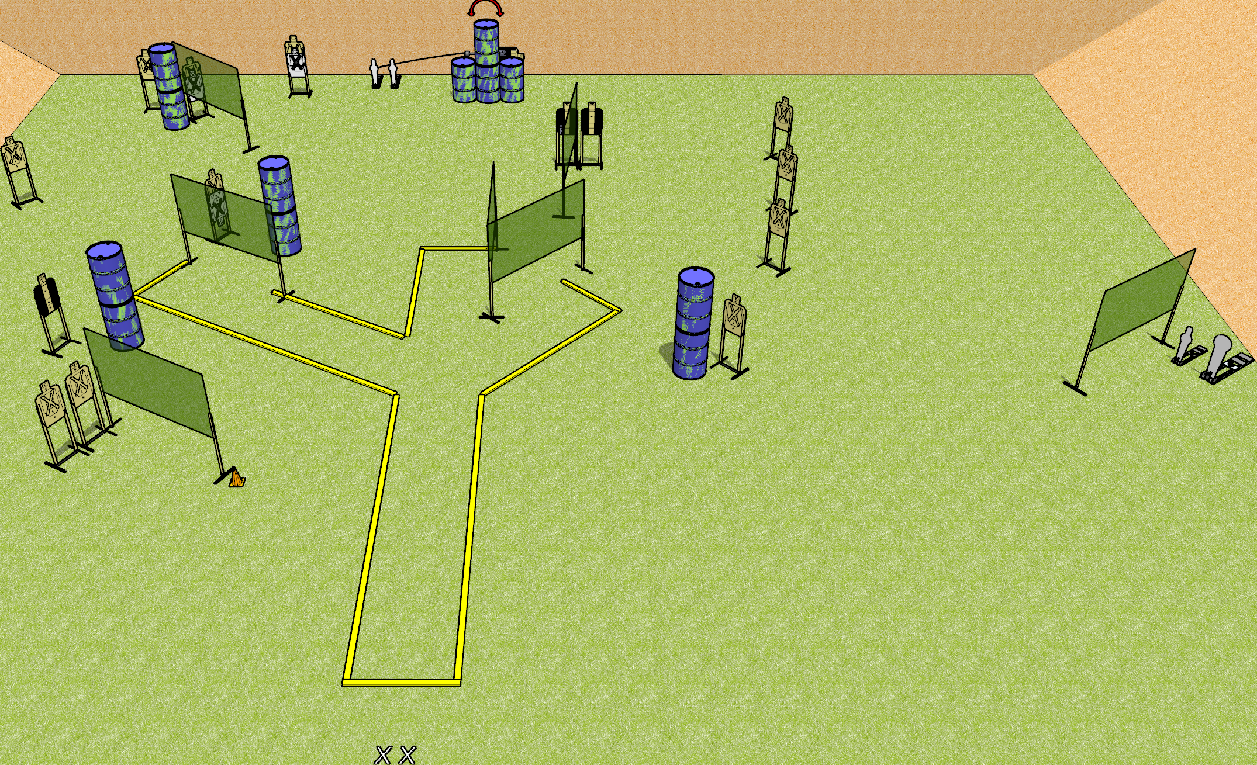
 | Dothan Gun Club – USPSA Match Just Plain Mean Course Designer : Drew Coleman
START POSITION : Standing with both feet on X’s, wrists below belt
GUN READY CONDITION : Pistol loaded and holstered. PCC loaded, shouldered, safety on, pointed at orange cone. |  | SCORING: Comstock, 34 rounds TARGETS: 15 paper, 4 Steel SCORED HITS: Best 2 on paper, steel until down START-STOP: Audible, last shot RULES:
STAGE PROCEDURE: Engage targets as they become available from within the fault lines.

Slide 18
Just Plain Mean
Written Stage Briefing
Just Plain Mean is a 34 round, 170 point, Comstock field course. There are fifteen USPSA targets, one Colt popper, and three mini poppers. The best two hits on paper will score. Steel must fall to score. The start signal is audible.
The swinger is activated by either of the mini poppers located nearby. Please check the activator before the first shooter and set it up the same way every time.
Handgun start position is standing with both feet on X’s, wrists below belt. Handgun is loaded and holstered.
PCC start position is standing with both feet on X’s, muzzle pointed at orange cone. Loaded carbine is held with both hands, safety on.
On start signal, engage targets as they become available from within the shooting area.

